Slide 1
Design Project DRIVER AND VEHICLE DOCUMENTS AUTHENTICATION SYSTEM USING ANDROID APPLICATION, WEB SERVER AND MYSQL Group Members: Lakshmipriya R Muhzin Nasser Rahul Mahesh Salu K L

Slide 2
Table of Contents
Introduction
Problem with the current system
Proposed System
Working Methodology
System architecture
Use case diagram
Flowchart
Block diagram
Application Wireframe
Advantages of Proposal
Future scope of the system

Slide 3
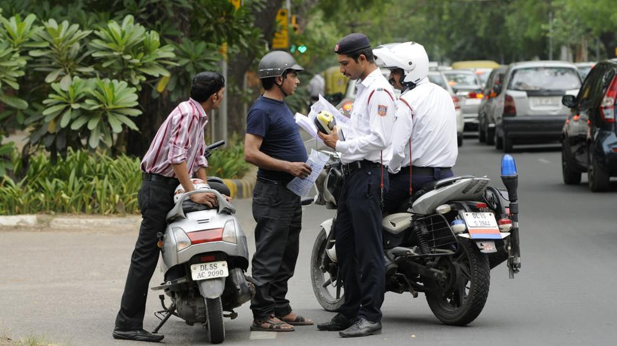
Remember this worst situation?
Think of a situation in which you forgot to take your vehicle documents and you are caught by traffic police asking for them.
Certainly you would be fined even though you have one…We are ought to change this situation.

Slide 4
CURRENT SCENARIO
Police checking and long process of verifications makes it difficult to drive even after all other precautions.
A website is provided by RTO where entry of license number provides needed information.
But is it useful ?
Vehicles are increasing thus increasing the problems of registrations, fake licenses and so on.
What are the necessary documents needed while driving!?
Its a burden for officers as well as us, why!?

Slide 5
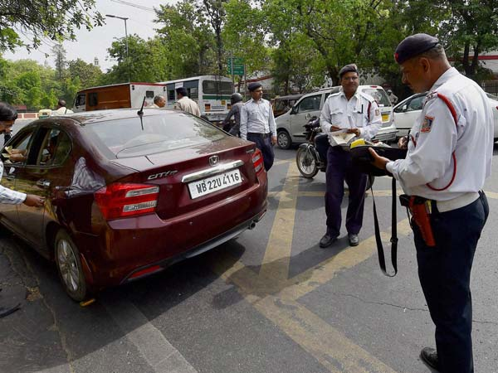
PROBLEMS OF THE CURRENT SYSTEM
Need to carry hardcopy of these long list of certificates everywhere. With bad luck, missing a certificate causes fine.
Process of lodging complaints inefficient.
Corruption in employee level and citizen level.
In case a vehicle is booked for any traffic violations, the details are uploaded onto a website. The owner is not updated with this information. If he fails to check this website regularly, he may not be aware of any pending traffic violations on his vehicles.

Slide 6
PROPOSED SYSTEM
Stores all the information related to vehicle and driver at database by RTO administrator.
Allows efficiently managing and verifying the documents related to vehicle and license.
The proposed system has an android application designed using JAVA and XML with dedicated user interfaces for each of the actors on the scene.
It connects the android device to the PHP script. This encoded data is then parsed and displayed on the android device.

Slide 7
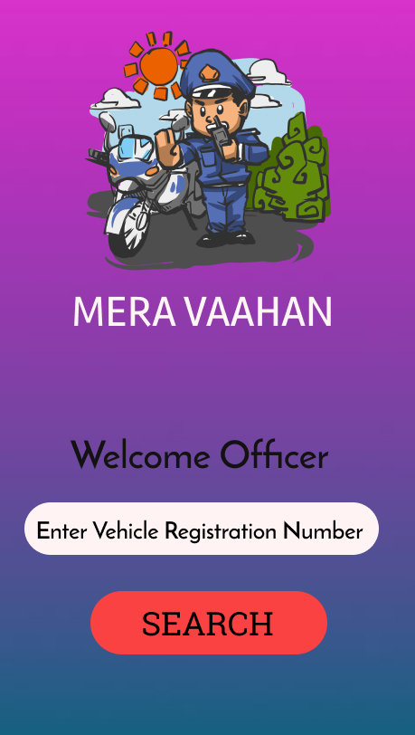
PROPOSED APPLICATION WIREFRAME
Place your screenshot here
How our proposal would be as per our thinking.

Slide 8
METHODOLOGY OF THE PROPOSAL
# influenced by E-RTO management system.
# no need to carry documents by the vehicle driver.
# Traffic police directly fetches information through the app.
RTO provides a unique id to user , while users upload documents and RTO verifies and permits them.
On client side an android application will be provided to police. After police logins into the system can retrieve vehicle and license related information from the RTO database.
Provides a method of abstraction.

Slide 9
STEPS INVOLVED IN THE PROCESS
Police
*Signs in through the android application using the user id provided to him as authentication.
*Can enter a vehicle number to view the owner’s or vehicle's documents.
*can generate fines or track vehicles as needed
3
General User
*Signs in through the android application using the user id provided to him as authentication.
*Can upload and view all the latest documents such as driving license, owned vehicle details, RC Book, latest emission test certificate, insurance copy, etc. on his profile page.
*Can report stolen vehicle to notify the nearest police.
2
RTO / Emission Test and Insurance Companies
*RTO registers the users with a driving license and provides a unique user id.
*They verifies the documents inserted by the users and permits authorization.
1

Slide 10
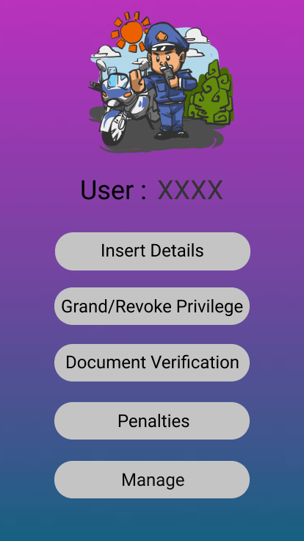
SYSTEM ARCHITECTURE
The architecture mainly consists of three modules:
A. RTO Module Architecture
Provides unique id to users and officials.
Users inserts data and RTO officials verifies and permits data inserted.
Manages the records.
Administration module of the database and has the whole control of the database.

Slide 11
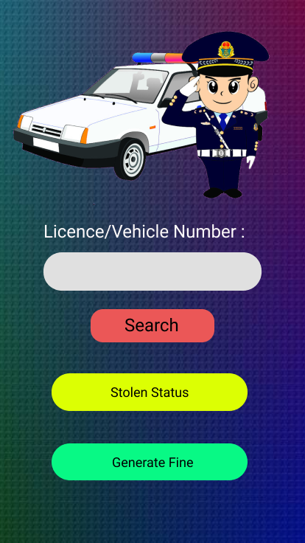
B. Police Module Architecture
Checks vehicle details.
Checks license and personal d e details.
Generate fine and digital receipt.
Update the stolen status of v v vehicle.
Contains vehicle information, d drdriver history, compliant no, and soon

Slide 12
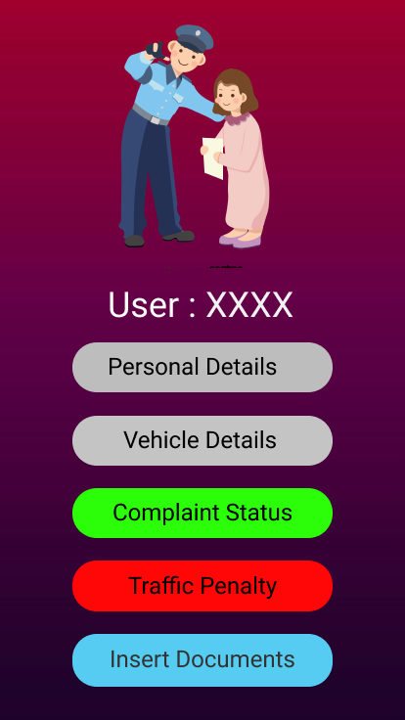
D. General-User Module
Signs in through the android application using the user id provided .
Can view all the latest documents such as driving license, owned vehicle details, RC book, latest emission test certificate, insurance copy, etc. on his profile page, u uploaded by user and verified by officials
Can report stolen vehicle to notify the nearest police.
Can check any unpaid offences on his vehicle.

Slide 13
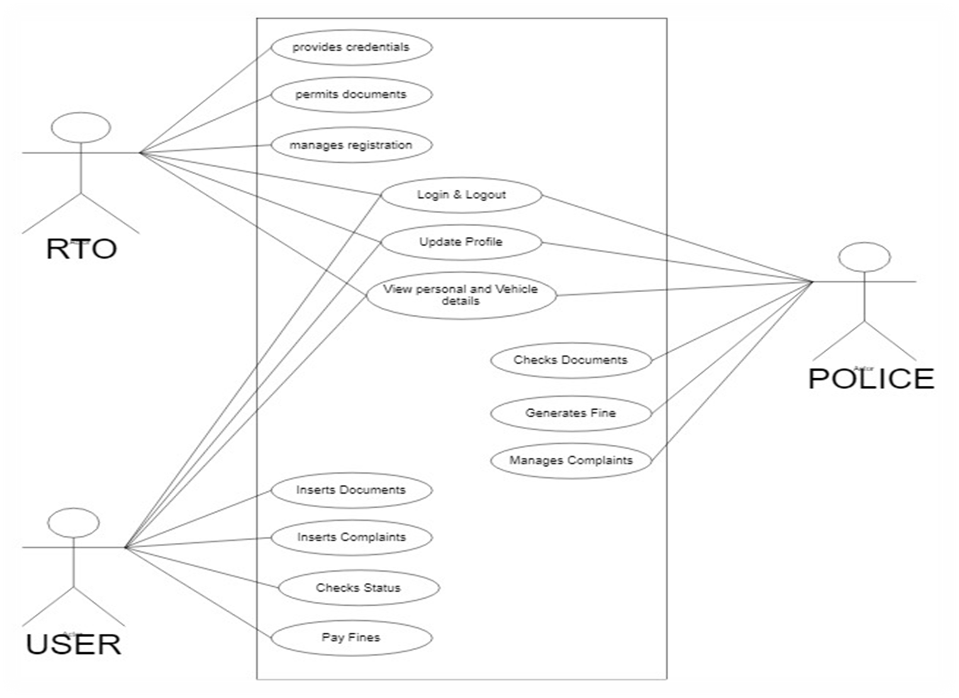
Use case
diagram

Slide 14
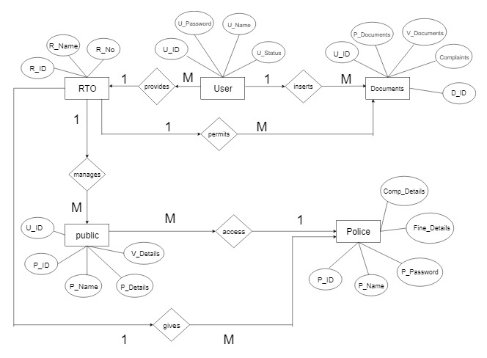
ER DIAGRAM

Slide 15
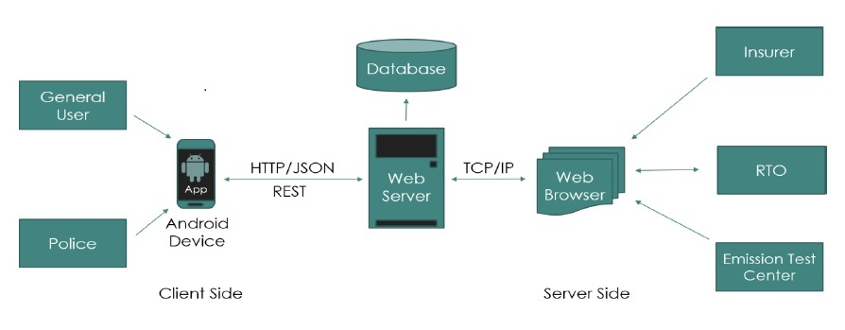
SYSTEM MODEL

Slide 16
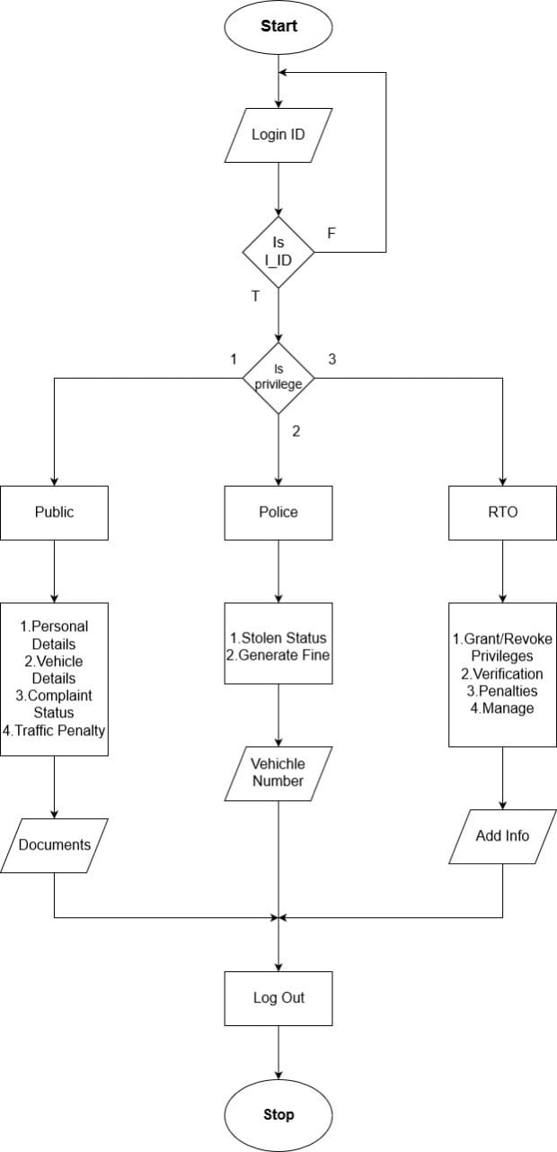
FLOWCHART

Slide 17
ADVANTAGES OF THE PROPOSAL
Less corruption in the transportation department.
No burden of carrying hard certificates everywhere.
To offer the drivers to be independent of vehicle related papers.
Push notifications allows easy updates and reminders.
Easy tracking of stolen vehicles and helps in time of accidents.
Helps the RTO officials to maintain records systematically and reduces a lot of paper work and manual efforts.
Security and protection
Data abstraction.

Slide 18
FUTURE SCOPE OF THE PROPOSAL
By linking it to the Aadhar Card database in order to retrieve more details of the license/vehicle owner.
GPS facilities in the phone also helps in steady tracking facilities.
Addition services may be added such as in-app service for ambulance assistance where accidents can be quickly reported which would allow both the police and ambulance drivers to respond to the emergency more efficiently.

Slide 19
THANK YOU

